Slide 1
Introduction to Radio Astronomy and it’s Effects on our Daily Living…
Notes:
Hello, my name is Ed. I’d like to give you an introduction to radio astronomy and some of the effects it’s had on our daily lives.

Slide 2
What does Radio Astronomy have over Optical?
Notes:
Where does the information about the universe come from for astronomers? Electro-Magnetic or EM waves are all that they have had to work with until the recent discovery of gravity waves. Both optical and radio waves are electro-magnetic waves - the only difference between them is the 'color' or frequency of the waves.

Slide 3
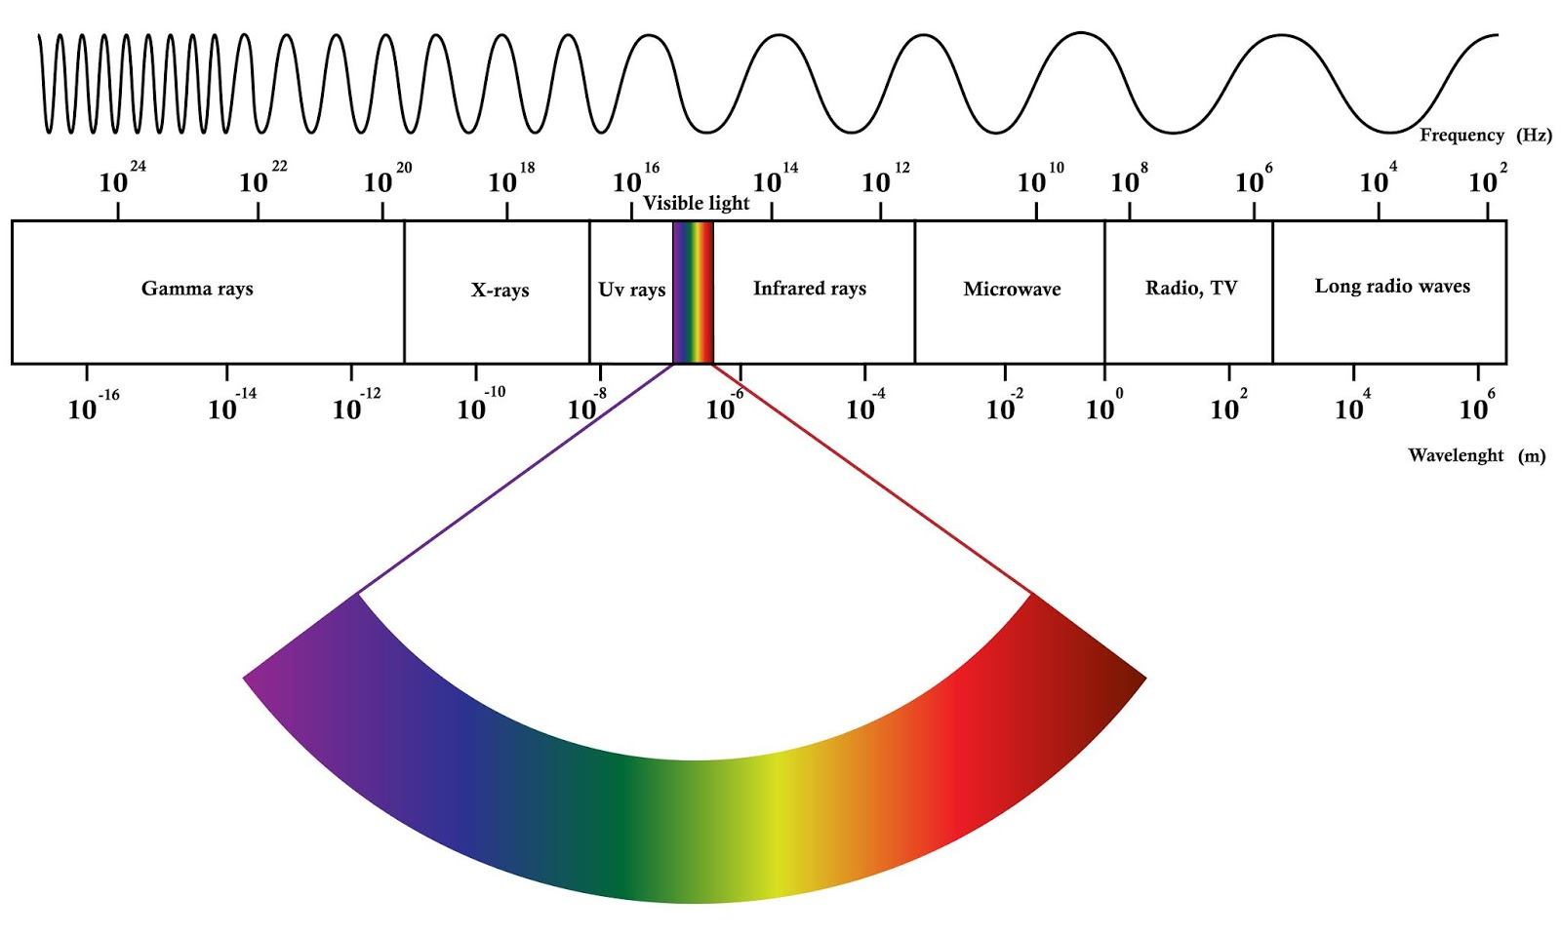
Notes:
For millennia, astronomers and astrologers have gazed up into the night sky, but they have only looked at a very small amount of information – visible light. This chart shows the EM spectrum from radio waves on the right to gamma rays on the left. That small sliver for visible light is the only thing we’ve be able to observe until the 1930’s.
Image Reference: PAPER - 604 : ELECTROMAGNETIC RADIATION (EMR) (lakhimi.blogspot.com) - https://lakhimi.blogspot.com/2020/05/electromagnetic-radiation-emr.html

Slide 4
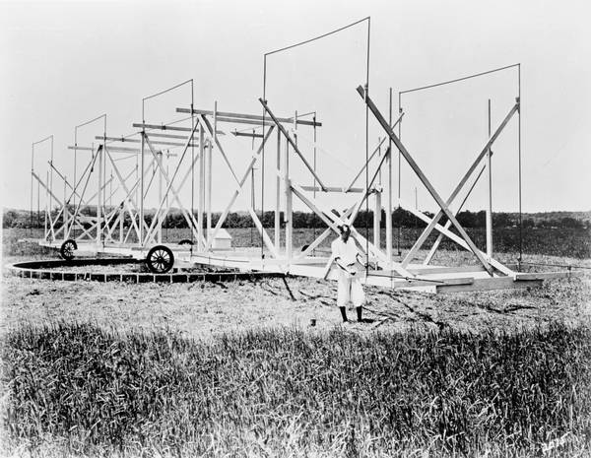
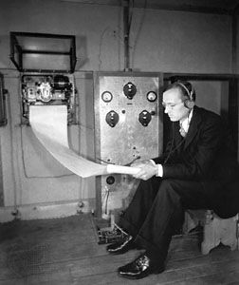
Father of Radio Astronomy
Notes:
Karl Jansky is recognized as the father of Radio Astronomy. Working for AT&T, he detected ‘a hiss of unknown origin’ that would interfere with AT&T’s plans for cross-Atlantic communications. He published the results in 1932. He wanted to research his discovery further, but AT&T told him to get back to work.
References:<ul>
<li>Karl Jansky and the Discovery of Cosmic Radio Waves - http://www.nrao.edu/whatisra/hist_jansky.shtml</li>
<li>Wikipedia article about Jansky unit - http://en.wikipedia.org/wiki/Jansky</li>
</ul>

Slide 5
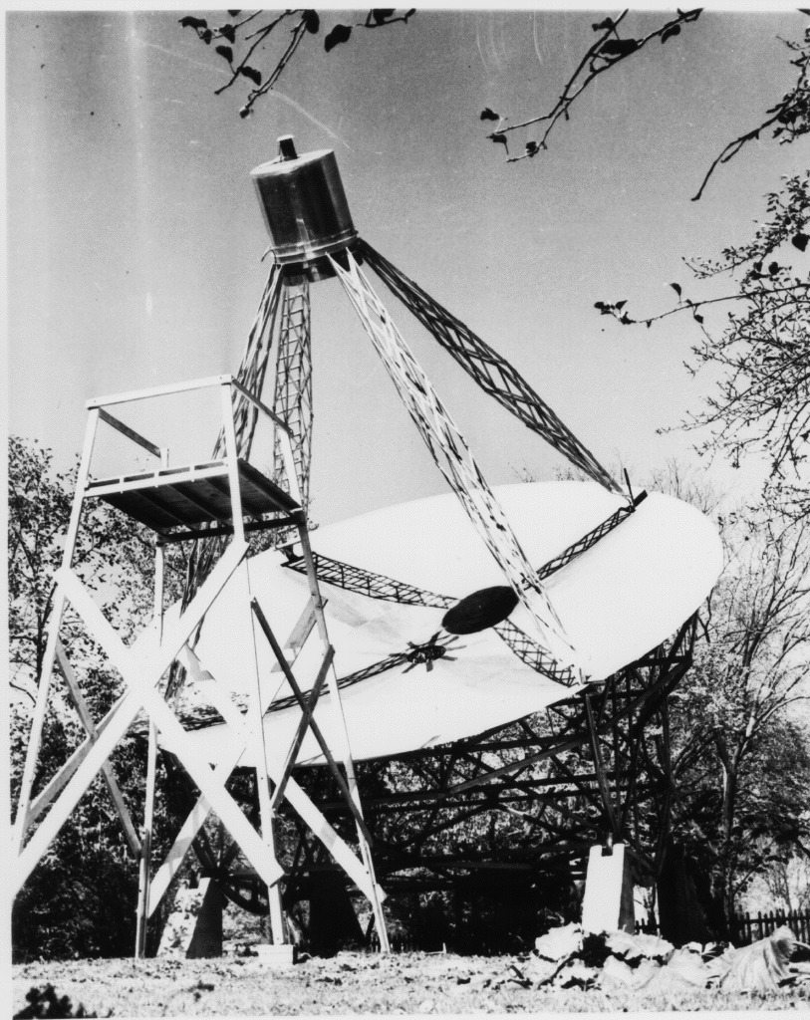
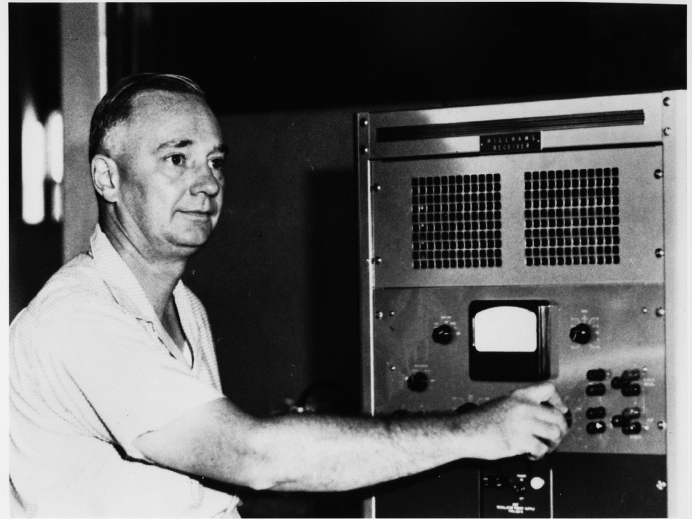
Grote Reber
Notes:
Grote Reber read Jansky’s paper and was curious. Then only 21, he built this 31.4’ dish in a side yard of his mother’s house and started observing the skies.
Like the astronomers of the day, he assumed the universe was thermal so the higher the frequency the more intense the signal. He started observing at 3.300 GHz… then 900 MHz and was unable to observe anything. But after moving to 160 MHz, he had success.
His view of the sky was able to distinguish things only about 7 or 8 degrees in size. (That’s about 15 times larger than the full moon in size.) The charts he made already had a very different view of the sky than optical astronomers had. There were several exceptionally bright objects that had no optical correspondence:
References:<ul>
<li>Grote Reber’s First Radio Telescope – National Radio Astronomy Observatory (nrao.edu) - https://public.nrao.edu/gallery/grote-rebers-first-radio-telescope/</li>
<li>Original NRAO article about Grote Reber - http://www.nrao.edu/whatisra/hist_reber.shtml</li>
</ul>

Slide 6
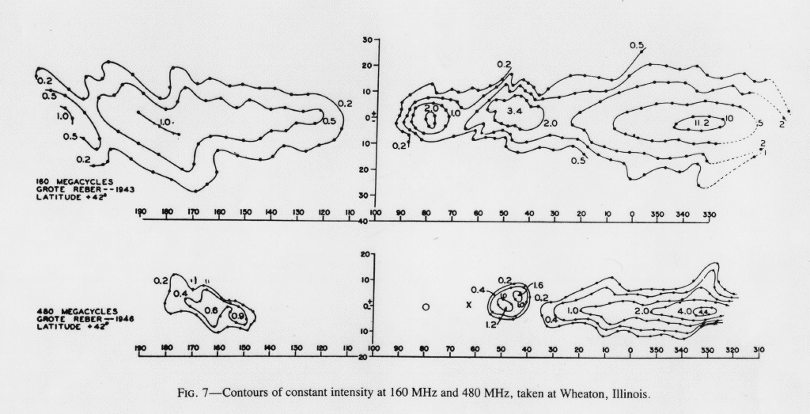
First Radio Graph of our Galaxy
Notes:
He surveyed the sky by watching a meter to record the signal strength and produced the first plot of the Milky Way in radio frequencies. A few astronomers grasp what was about to happen, but the certainty that the universe was thermal, the Great Depression and World War II initially interfered.
Certainty that the universe was certain… What???
References:<ul>
<li>NRAO article about Grote Reber - http://www.nrao.edu/whatisra/hist_reber.shtml</li>
</ul>

Slide 7
State of the art at the time in the 1930’s…
Astronomers KNEW the universe was thermal.
Radio was some new-fangled technology that was not going to see much due to the the low emission as predicted by the Stefan-Boltzmann equation.
Radio telescopes have poor resolution. (Initial scopes had resolution measured in degrees)
Most professional astronomers knew nothing about radio, so they assumed whatever was being received was probably just local noise.
Notes:
State of the art for astronomy at the time…
Astronomers KNEW the universe was thermal. Quantum mechanics was new and few understood the implications.
Radio was some new-fangled technology that was not going to see much due to the low power as predicted by the Rayleigh-Jeans black-body law.
Radio telescopes have poor resolution. (Initial scopes had resolution measured in degrees)
Most professional astronomers knew nothing about radio so whatever was being received was probably just local noise.
Lastly, a major issue was that this was the time of the Great Depression. Money was very scarce for research. This bias by most astronomers made radio astronomy appear to be of little use and a waste of scarce money.
There were a few places where some initial research was performed. Practically, Grote Reber was the only radio astronomer until after World War II.
What did he observe?
References:<ul>
<li>NRAO article about Grote Reber - http://www.nrao.edu/whatisra/hist_reber.shtml</li>
</ul>

Slide 8
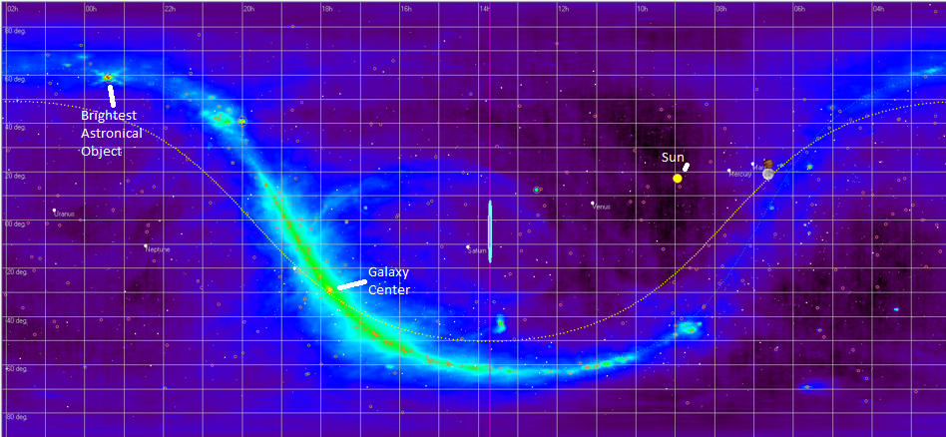
The Whole Sky at 408 MHz.
Notes:
This is the view of the sky at 408MHz. You can clearly see the outline of the Milky Way and the center of our galaxy. The brightest object in our radio sky – the Sun is visible too. However, excluding the Sun, the brightest object is not our galactic black hole, but rather is located in the upper left as a small object that is exceptionally bright...
References:<ul>
<li>Image generated using RadioEyes - http://radiosky.com/radioeyesishere.html</li>
</ul>

Slide 9
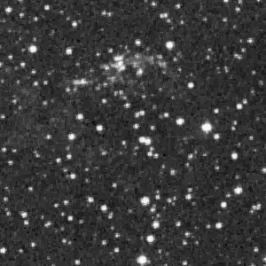
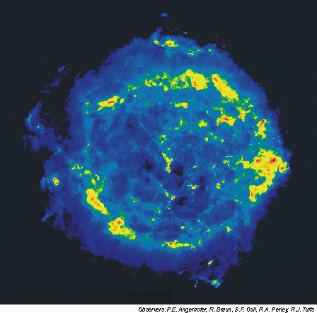
Supernova Remnant Cassiopeia A
Notes:
Cassiopeia A is that exceptionally bright object. As you can see on the left in an optical telescope, the area is fairly plain. But in radio the same area is dramatically different. This object is the result of a super nova that is 'glowing' in the radio frequencies.
(Images are the same scale.)
References:<ul>
<li>Cassiopeia A (3C461) data from RadioEyes - http://radiosky.com/radioeyesishere.html</li>
</ul>

Slide 10
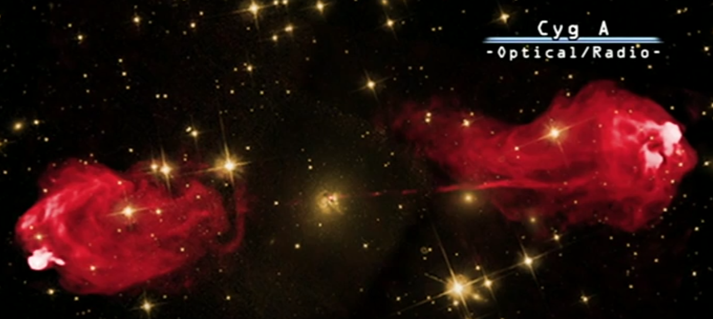
Radio Galaxy Cygnus A
Notes:
The second brightest… is a galaxy! Despite being another galaxy millions of lightyears away, this source was bright enough for Grote Reber to observe with his early telescope. The radio source is in red and the rest is visible light. Optically the source is small. In radio, those huge lobes are easily visible. In terms of energy, those lobes have enough energy to take EVERY star from the Andromeda galaxy (billions of stars) and set it free from the galaxy.
To drive home our eyes are not the best sensors for everything we can observe…
References:<ul>
<li>Image - https://www.researchgate.net/figure/Extragalactic-radio-source-Cygnus-A-The-host-galaxy-is-imaged-in-the-optical-band-shown_fig1_242684990</li>
<li>Great Courses: Radio Astronomy, Observing the Invisible Universe. Lesson 17 – Radio Source Counts</li>
</ul>

Slide 11
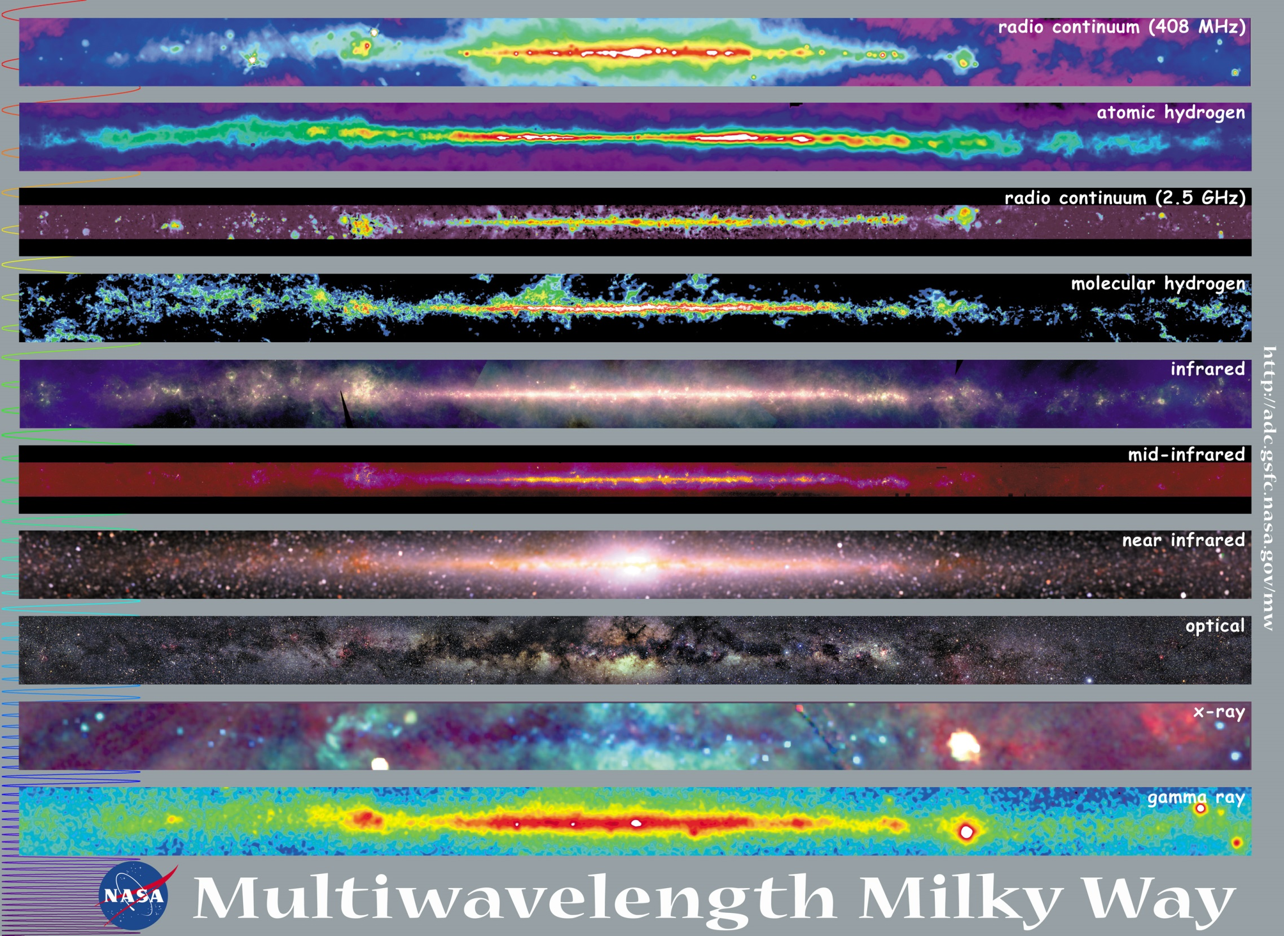
Notes:
This is our galaxy in various wavelengths. As you can see, different wavelengths have different views of the exact same object. Each band has its advantages and disadvantages. Optically, we cannot even see the center of our galaxy but in radio and other bands we see new and different things. Grote Reber was the first person to see the center of our galaxy was really a very bright object that needed more investigation.
Until telescopes were put into space, only the optical and the first 3 or 4 radio views were available to scientists.
References:<ul>
<li>Multiwavelength Milky Way - http://mwmw.gsfc.nasa.gov/</li>
</ul>

Slide 12
What the professionals use
Notes:
Grote Reber’s modest telescope has evolved into a series of telescopes that have observed and defined our universe in detail undreamt of. Here are some of the telescopes that professionals use…

Slide 13
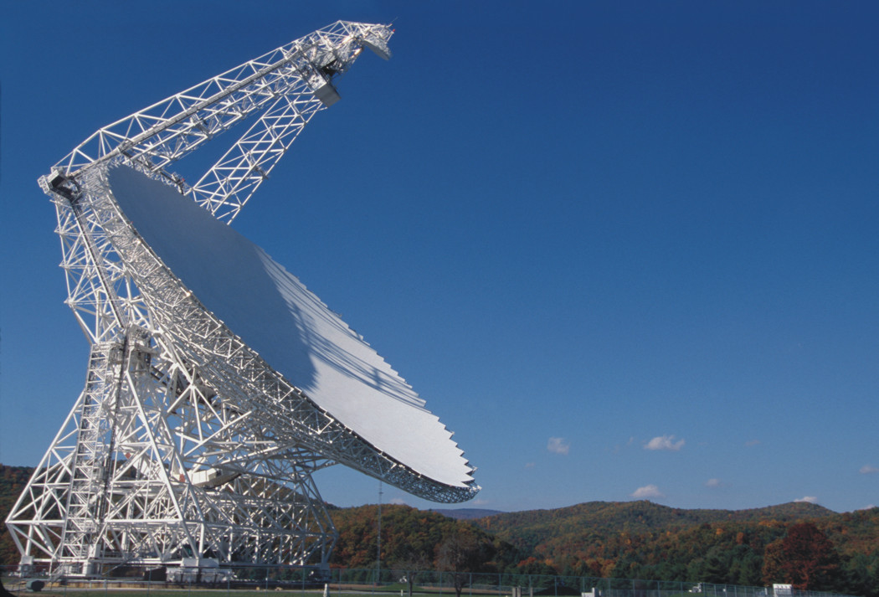
Image courtesy of NRAO/AUI
Notes:
This is the 100-meter radio telescope in Green Bank, West Virginia. It is located in a radio quiet zone. It is an extremely sensitive device that continues to push new boundaries in research. References:<ul>
<li>Radio Astronomy, July-August 2014 p 84.</li>
<li>Green Bank Telescope - https://public.nrao.edu/telescopes/gbt</li>
</ul>

Slide 14
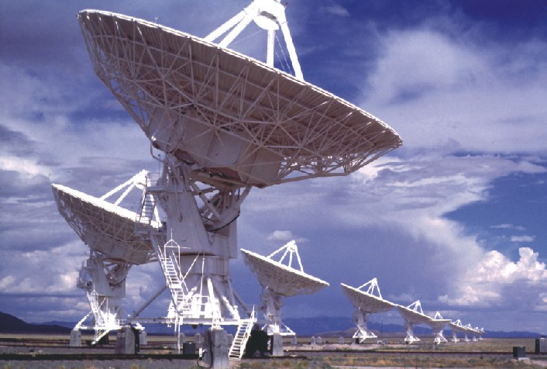
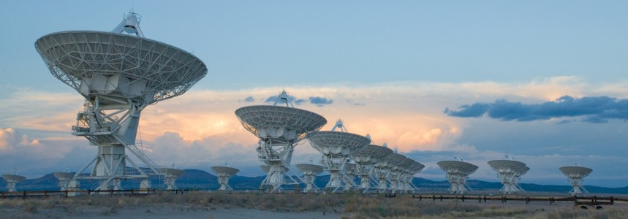
VLA
Notes:
This is the Karl Jansky Very Large Array (or VLA) and it one of the world’s premier astronomical radio observatories. It has 27 movable radio antennae (each 25 meters in diameter) in a Y-shape configuration as an interferometer. This allows all the dishes to operate together as a single huge dish rather than each dish operating separately. As the individual antennae move apart, the resolution increases. At their maximum distance of 34 kilometers apart, the facility can get 0.04 arc-second resolution. (Hubble resolution is 0.05 arcsecond.) References:<ul>
<li>NRAO Very Large Array - http://www.vla.nrao.edu/</li>
</ul>

Slide 15
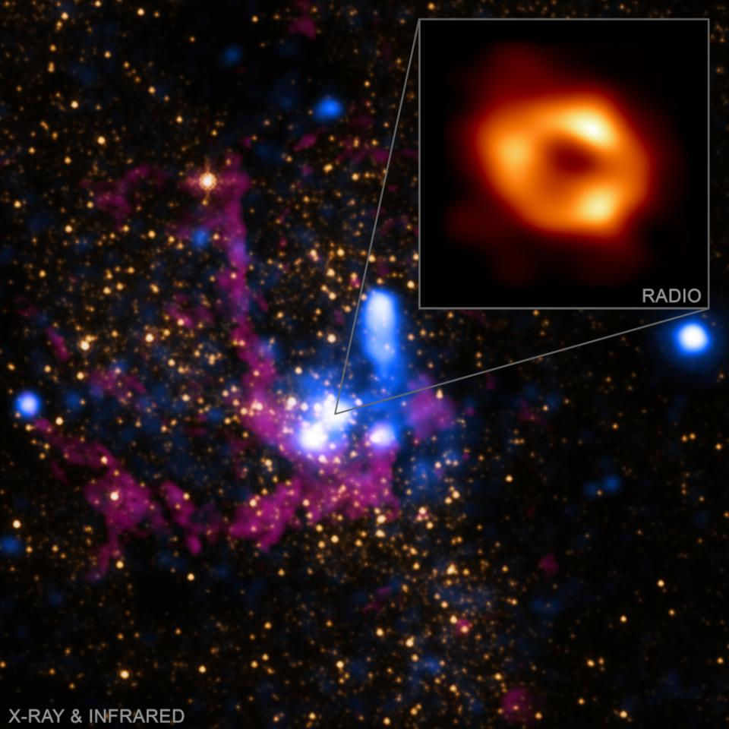
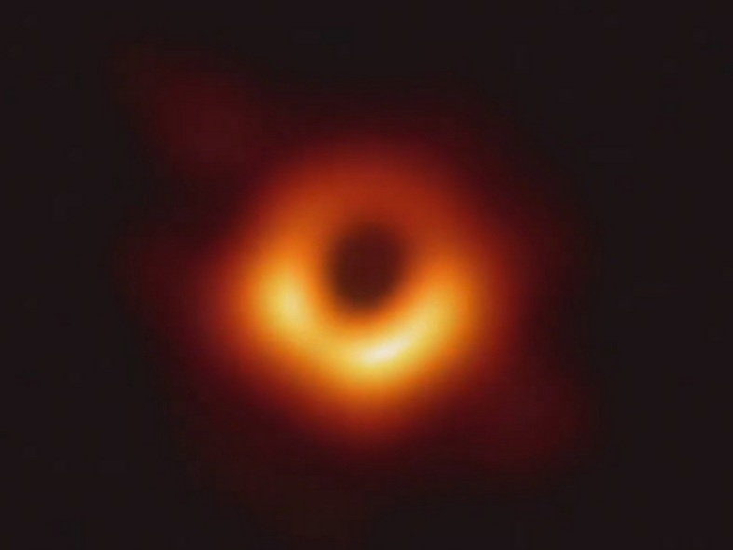
Event Horizon Telescope
M82
Sagittarius A*
Notes:
While we’ve been exposed to the new name of “Event Horizon Telescope” in recent years, this is really elements of the Very Long Baseline Interferometer (or VLBI) dedicated to imaging the event horizon of galactic center black holes. The VLBI is composed of radio observatories spanning the globe. With a theoretical diffraction-limit of about 20 micro-arcseconds, we are able to image enough detail to generally resolve the accretion disk of the black hole. This is about 1/50,000 of the diameter of the Moon in size.
References:<ul>
<li>The Milky Way's Black Hole | Science Mission Directorate (nasa.gov) - https://science.nasa.gov/milky-ways-black-hole</li>
<li>Event Horizon Telescope – Wikipedia https://en.wikipedia.org/wiki/Event_Horizon_Telescope</li>
</ul>

Slide 16
What do the amateurs use?

Slide 17
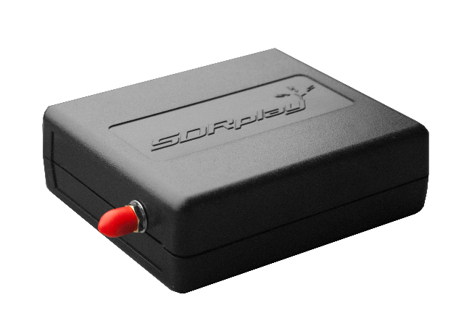
Eyepieces…
Notes:
In the radio astronomy realm, we use radio receivers. Professionals use liquid helium cooled amplifiers and extremely expensive, custom designed wide-band receivers to gather their images. Amateurs use these cheap receivers readily available on the internet for about $40 and $250 respectively. The best receivers (that are also available to professional observatories) are around $1000. The top receiver at about $40 is the equivalent of a basic Plossel. The bottom at about $250 is a Nagler… and they are the “COMPLETE COLLECTION” of eyepieces regardless of the band that you might be observing in!
Antennae include…
References:<ul>
<li>http://www.nooelec.com/store/sdr/sdr-receivers/nesdr-smart-xtr-sdr.html</ul>
</ul>

Slide 18
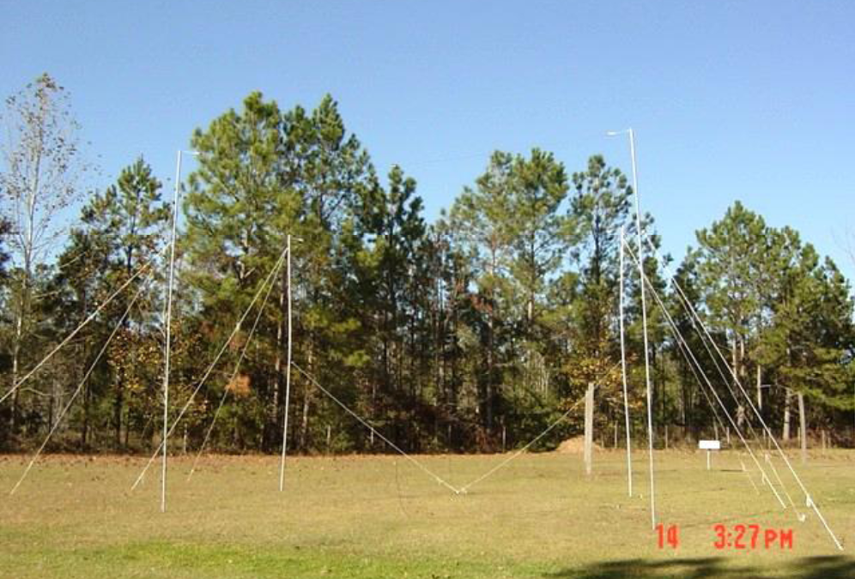
Radio Jove http://radiojove.gsfc.nasa.gov/
Notes:
NASA started the Radio Jove project to monitor the Jovian system and is today still gathering and analyzing the data from hundreds of sites around the world. A side benefit is that this research is providing insights into our atmosphere here on planet Earth. Bursts are not always recorded at all observing sites despite being ‘relatively’ close by. Ionization pockets in our own atmosphere are now known to play a part in this behavior and are actively being researched as to their cause and size. This discovery was announced only a decade ago. This is still ongoing research and is still collected and used. This information about these ionization pockets is being used by NASA to help know how to communicate with the spacecraft around the solar system!
References:<ul>
<li>Radio Jove Solar & Planetary Radio Astronomy for Schools - http://radiojove.gsfc.nasa.gov/</li>
</ul>

Slide 19
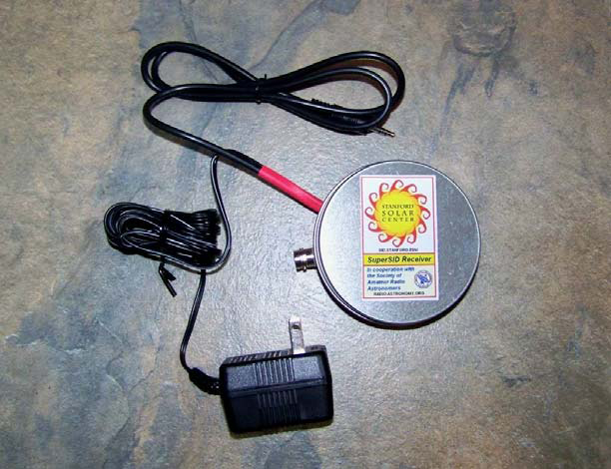
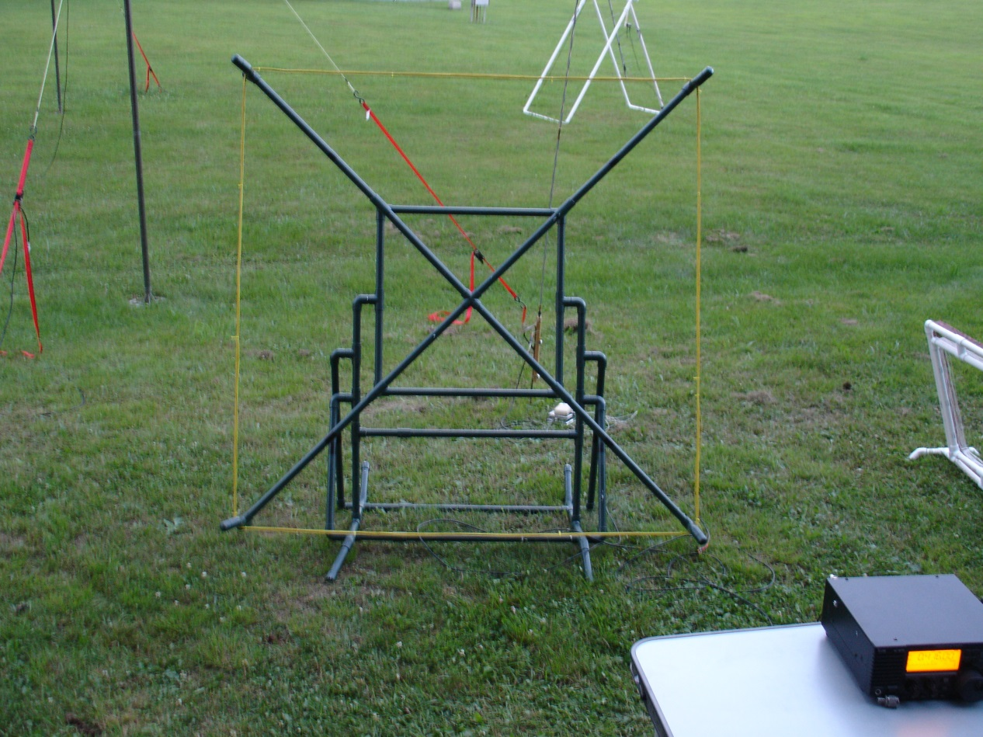
SuperSID
Notes:
SuperSID, is a Stanford program to gather information about Sudden Ionospheric Disturbances. SuperSID listens to VLF transmitters used to communicate with submarines. By monitoring these VLF radio stations and watching their signal strength change, they measure the changes in our ionosphere. Whenever Earth’s ionosphere is disturbed by the solar wind, the signal strength changes. This system is easy to bring online for automatic data collection and upload to Stanford. The receiver is preassembled and creating the antenna is very easy. (Technically, the receiver is just a very low noise op-amp and the sound card in most PCs. The antenna is a simple loop antenna.)
The CME this past June was easily detected by this system. It was strong enough to compress the Sun side’s ionosphere to 1/5th it’s normal depth.
References:<ul>
<li>Bottom left photo – Ed Harfmann SARA Conference 2013</li>
<li>Space Weather Monitors - Stanford SOLAR Center - http://solar-center.stanford.edu/SID/sidmonitor/</li>
<li>https://scitechdaily.com/massive-solar-storm-sparks-rare-g4-alert-what-it-means-for-earth/</li>
</ul>

Slide 20
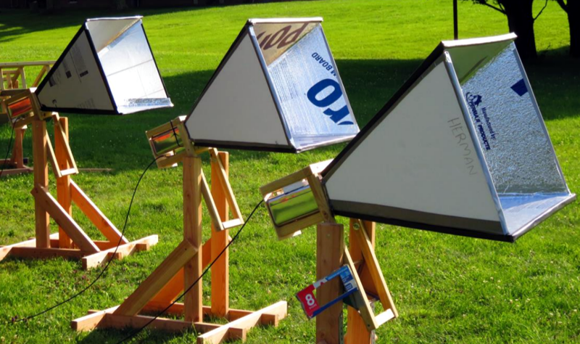
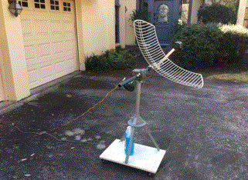
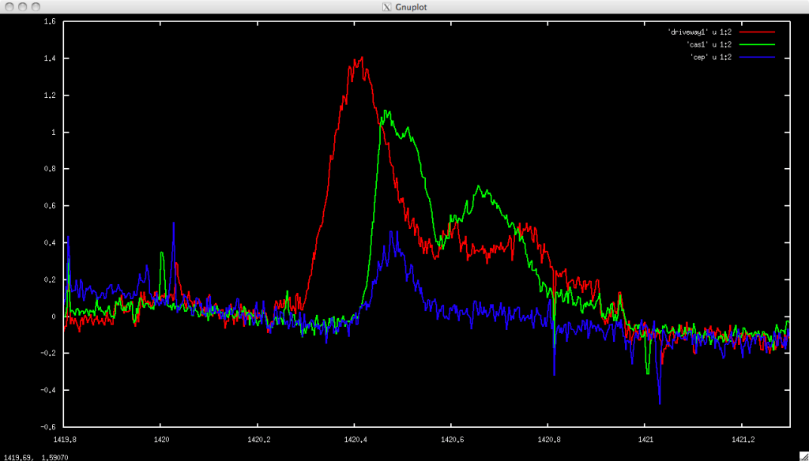
Hydrogen Line http://wvurail.org
Notes:
Reception of the hydrogen line is not difficult and there are several easy to construct designs out there. This feed-horn design on the top right is from wvurail.org and uses 2x4 lumber for the frame and aluminized foam board for the horn. An amplifier and receiver are all that are needed see the Doppler shift of the hydrogen line in our galaxy's arms. Their web site has complete instructions on creating such a telescope.
On the left is “Scope In A Box” supplied by SARA. Some minor assembly of the antenna with a screwdriver and wrench and you are ready to receive. You might notice that the antenna is designed for WIFI but the antenna is easily able to also receive the hydrogen line. If you can connect a TV, you can build this.
Of course these are ‘beginner’ instruments, there are some members who have some better toys to play with!
References:<ul>
<li>Horn image https://wvurail.org/dspira/labs/06/</li>
<li>Graph https://www.rtl-sdr.com/horn-antenna-rtl-sdr-radio-astronomy/</li>
</ul>

Slide 21
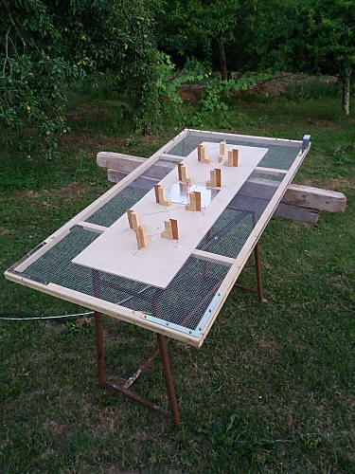
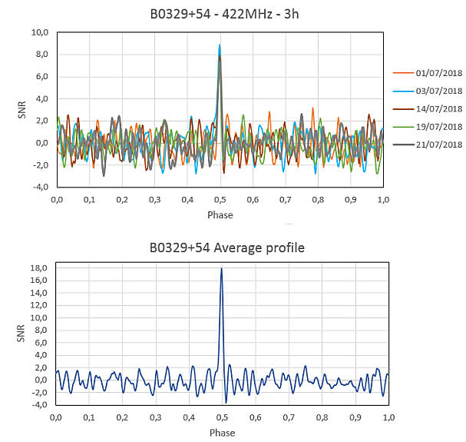
Pulsar detection is possible.
Notes:
Pulsars provide only a brief pulse that is not that much above the noise level for most amateur systems. That said, amateur radio astronomers have detected pulsars. Ok, not new pulsars but existing ones. By knowing the cycle of the pulsar signal, you can fold hours (or in the case shown - 5 days) of signal into a detection.
One amateur, Steve Onley at the HawkRAO, used a 3-meter dish to detect a glitch of the Vela pulsar. (A glitch is a sudden change of the spin rate of the pulsar… usually measured in parts-per-million.) This was the first glitch detected by an amateur before the professionals.
For the seriously high end amateur radio astronomer…
Reference:<ul>
<li>http://hawkrao.joataman.net/index.html</li>
<li>http://neutronstar.joataman.net/sites/iw5bhy_barga_3/index.html</li>
<li>https://ui.adsabs.harvard.edu/abs/2021ATel14808....1O/abstract</li>
</ul>

Slide 22
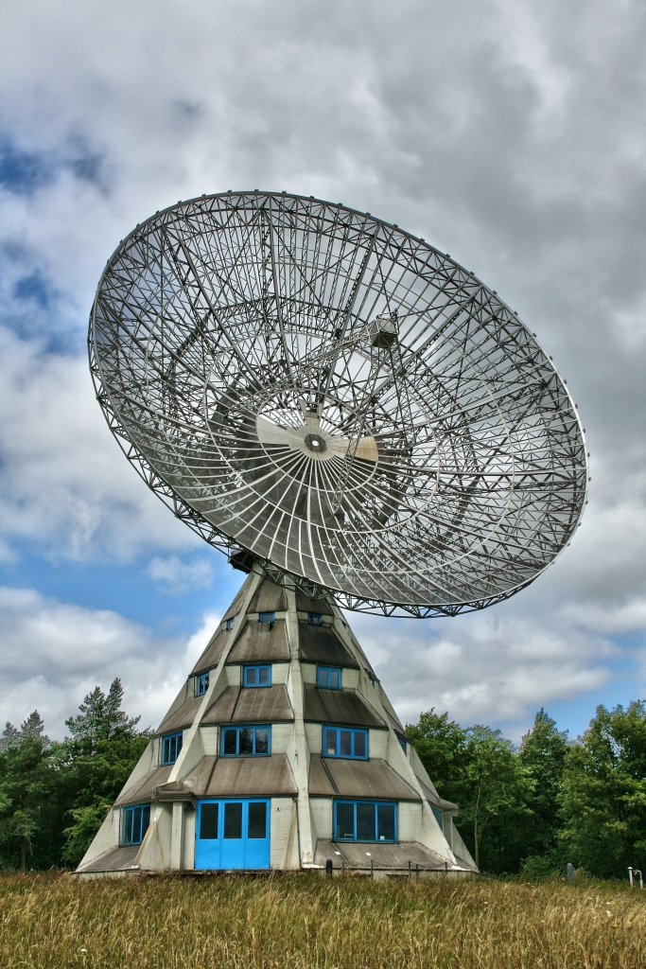
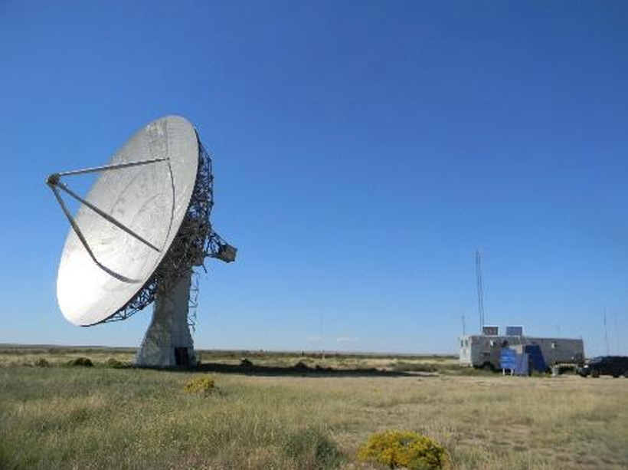
Bigger toys…
Notes:
These are at the SERIOUSLY high end.
Astropeiler Stockert (on the left) is a 25 meter research scope that was decommissioned. A group got together, put in new electronics and it has been doing research ever since.
Deep Space Exploration Society - DSES (on the left) took an old DEW line 9 meter dish and refurbished it.
Earlier this year DSES transmitted a radar pulse off of Venus which was received by Astropeiler’s dish. This was the first successful Venus bounce by amateurs. Early results have been published in the SARA journal. (Analysis of the bounce is still ongoing.)

Slide 23
What has radio astronomy added to our knowledge of our univserse?

Slide 24
Imaging Black Holes
Notes:
Imaging a black hole.
References:<ul>
<li>Black hole image - https://www.jpl.nasa.gov/edu/news/2019/4/19/how-scientists-captured-the-first-image-of-a-black-hole/</li>
</ul>

Slide 25
Non-Thermal Radiation from Galaxies
Notes:
Non-thermal radiation from galaxies…
References:<ul>
<li>Image - https://www.researchgate.net/figure/Extragalactic-radio-source-Cygnus-A-The-host-galaxy-is-imaged-in-the-optical-band-shown_fig1_242684990</li>
<li>Great Courses: Radio Astronomy, Observing the Invisible Universe. Lesson 17 – Radio Source Counts</li>
</ul>

Slide 26
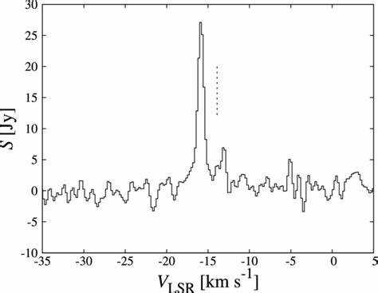
Coherent Maser Line Emission
Notes:
Coherent maser line emission from interstellar ions and molecules. Lasers in microwave frequencies around other stars. This particular maser is with water so it would cook your frozen turkey into turkey flambee in mere moments… At an estimated 20 kilo-parsec from Earth, this microwave is about 23 Giga Watts!
References:<ul>
<li>Spectrum image - https://www.researchgate.net/figure/Total-power-spectrum-of-H2O-maser-emission-toward-G747-006-in-the-Mizusawa-station-on_fig1_304033187</li>
</ul>

Slide 27
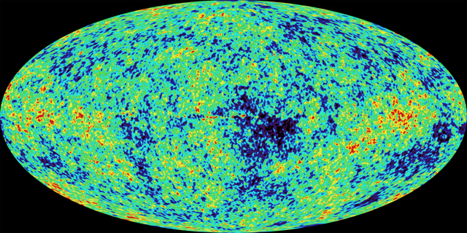
Cosmic Microwave Background
Notes:
This was part of the body of works used to change ‘The Big Bang’ from a joke into the leading candidate for how the universe was created and evolved. This satellite image shows the infant universe where galaxies were are being to form.
References:<ul>
<li>Image: https://www.nasa.gov/centers/goddard/news/topstory/2003/0206mapresults.html</li>
<li>Information: https://en.wikipedia.org/wiki/Cosmic_microwave_background</li>
</ul>

Slide 28
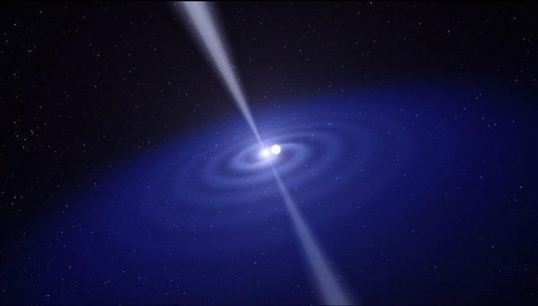

Neutron Stars (aka Pulsars)
B1933+16
0.356 S
B0531+21
33.4 mS
B1937+21
1.56mS
Notes:
Neutron stars – These small stellar core remnants at only about 10-12 miles across have been detected via the pulsars that form from new and renewed neutron stars. Being so small, their detection with an optical telescope was practically impossible.
This binary drawing relates to the indirect but convincing evidence for gravitational radiation (and allowed the discoverer to earn a Nobel prize). (Courtesy of Dr. Joe Taylor who was the keynote speaker to SARA in 2014.) </li>
Here are the sounds made by these over-sized nuclei…
How many of you have observed M51? …
References:<ul>
<li>Pulsar in binary system - http://www.trbimg.com/img-517ad6cf/turbine/la-einstein-relativity-20130426-001/600/600x341</li>
</ul>

Slide 29
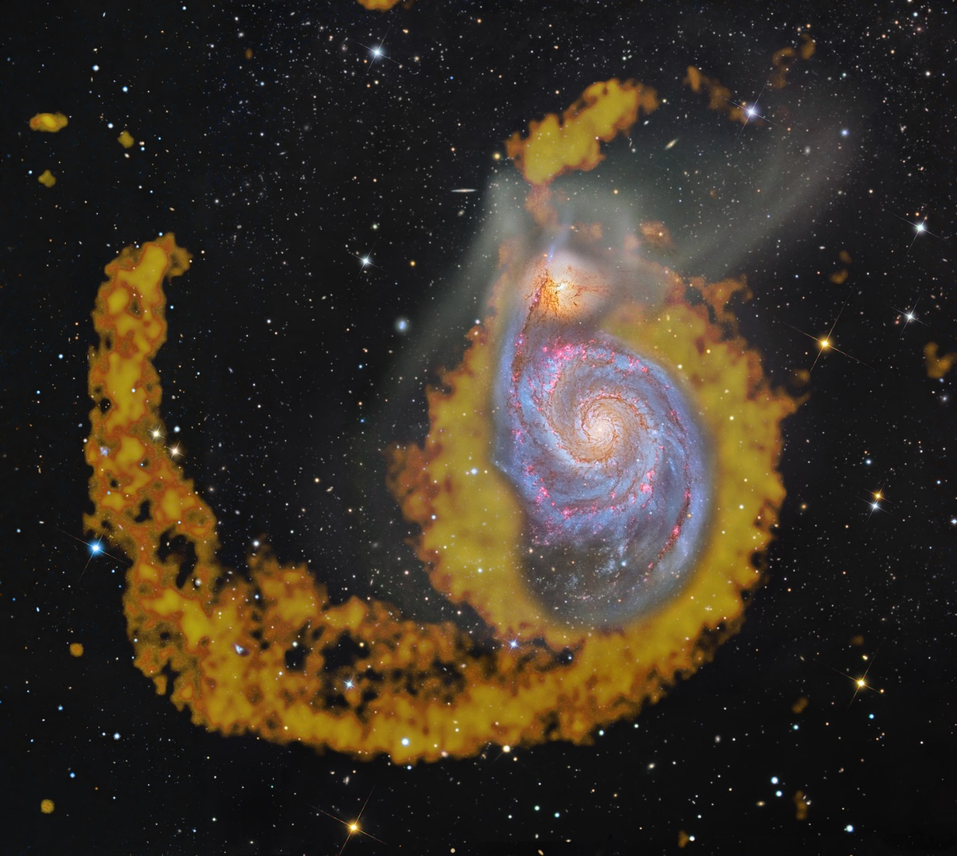
Galaxies extend way beyond their visible area…
Notes:
This is M51 in both radio and optical. The orange is the hydrogen gas that is associated with the galaxy.

Slide 30
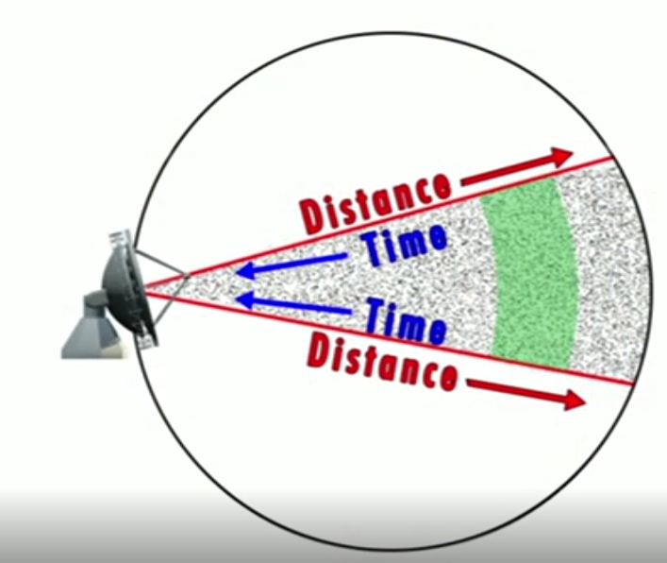
Evolution of Radio Galaxies and Quasars
Notes:
As we’ve looked back in time, the radio galaxies and quasars have shown that there was a time when these were extremely common but not so much now.
References:<ul>
<li>Image – Great Courses; Radio Astronomy – Observing the Invisible Universe, Lesson 17 – Radio Source Counts</li>
</ul>

Slide 31
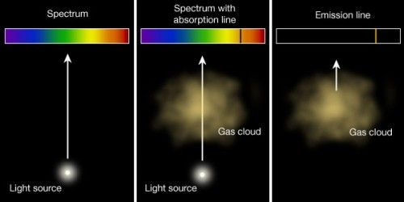
Thermal spectral-line absorption and emission
Notes:
We know there are clouds of gas between us and distant galaxies by examining the absorption (center) and emission lines (right) of distant objects. Some are within a galaxy; some are in the vacuum of space. Astronomers have even found multiple clouds at different distances between us and some of the sources.
References:<ul>
<li>Image - https://www.pinterest.com/pin/221169031674374079/</li>
</ul>

Slide 32
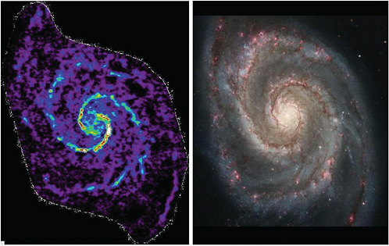
Cold areas of galaxies
Notes:
To the left is a map of Carbon-monoxide which can only survive in dark, cold areas of space. (In clear space, the molecule quickly breaks down.) The left is the optical image. Those CO rich areas are located in similar locations within our Milky Way.
Image reference:
<ul>
<li>https://nap.nationalacademies.org/read/12800/chapter/5#101</li>
</ul>

Slide 33
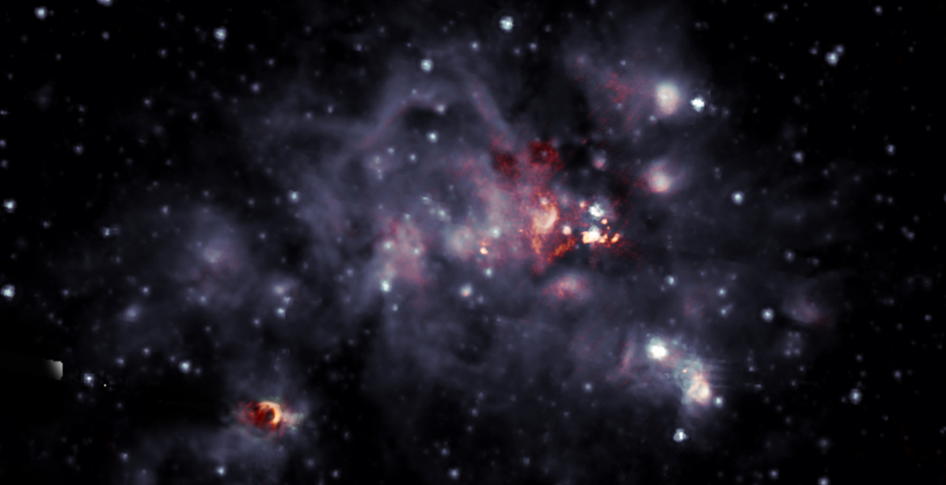
A peek into the nursery…
Notes:
As shown previously in the NASA image of our galaxy, the galaxy is filled with opaque clouds of gas. Radio sees inside the clouds to see stars being formed.
Image Credit:
<ul>
<li>https://public.nrao.edu/news/new-look-bright-stellar-nursery/</li>
</ul>

Slide 34
Technologies started in Radio Astronomy in everyday use…
Notes:
Every scientific research area generates a lot of new information and knowledge. Some may ask the question “What has radio astronomy brought to my everyday life?”

Slide 35
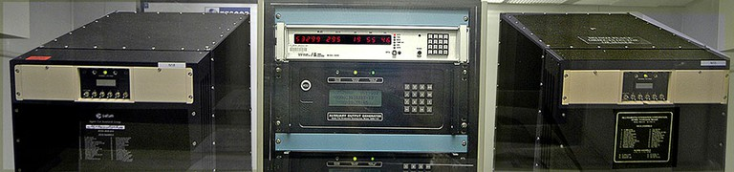
Time Keeping
Notes:
Within our daily life, we have much less accurate clocks to keep us on schedule. There is one question that we rely upon… “When is noon?”
While optical astronomy has provided timekeeping for centuries, radio has upped the game…
The US Naval Observatory (USNO) maintains the master clock for time use within the United States. These atomic clocks keep master time to within 10 nanoseconds. But the question remains, when is noon?
USNO uses both optical and radio telescopes to measure the location of quasars with a very high degree of accuracy. The stars involved vary with the time of the year and are monitored. This monitoring has resulted in the detection of the change of rotation rate of the Earth as well as the wobble of its axis. These changes are monitored, logged and contemplated. When the rotation rate has changed ‘enough’, a leap second is introduced to reconcile the atomic clocks with our day. Were it not for this occasional leap second, our clock would slowly change such that noon would happen at midnight.
Aside from the occasional leap second, the changes are fed into the GPS system to maintain the correct time information used by the satellites. Without these corrections, the times would diverge, and the GPS system would become useless very quickly.
References:
<ul>
<li>Image: https://www.cnmoc.usff.navy.mil/Our-Commands/United-States-Naval-Observatory/Precise-Time-Department/The-USNO-Master-Clock/The-USNO-Master-Clock/</li>
<li>Radio Astronomy - Observing the Invisible Universe, Lesson 19 - A Telescope as Big as the Earth</li>
</ul>

Slide 36
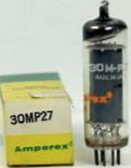
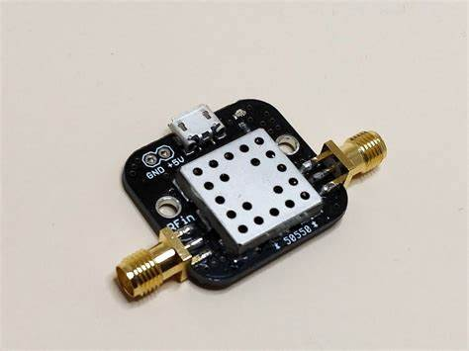
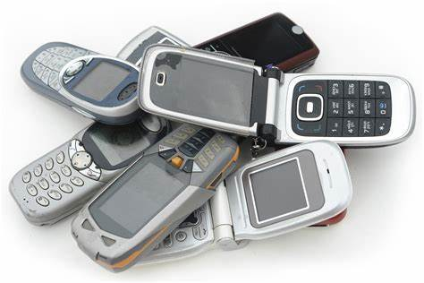
Amplifiers
Notes:
The technology needed to explore the universe has driven, and been driven, to use quieter and quieter devices. The vacuum tube has given way to semiconductors which has enabled everything including cell phones to be created.
The technology needed to create these new amplifiers require clean rooms the quality that had never been seen before. The technology has been used to in medicine to create clean rooms required for operation theaters as well as semiconductor manufactures.
While radio astronomy was not the emphasis of the drive to semiconductors, the low noise aspect was. Without that drive to lower noise, cell phones would be much more powerful… maybe the fear of cell phones giving us cancer is from a parallel universe that did not have this drive and we’re holding 100-watt transmitters to our heads?? :>
References:
<ul>
<li>System Temperature vs Time – But It Was Fun, page 115, ISBN 0-9700411-2-8</li>
<li>SARA Forum discussions - What are the everyday benefits of Radio Astronomy?
<https://groups.google.com/g/sara-list/c/uldlYMwqX4A/li>
<li>Higher speed WiFi - https://iau.org/static/archives/announcements/pdf/ann19022a.pdf</li>
<li>Stock images from the web</li>
</ul>

Slide 37
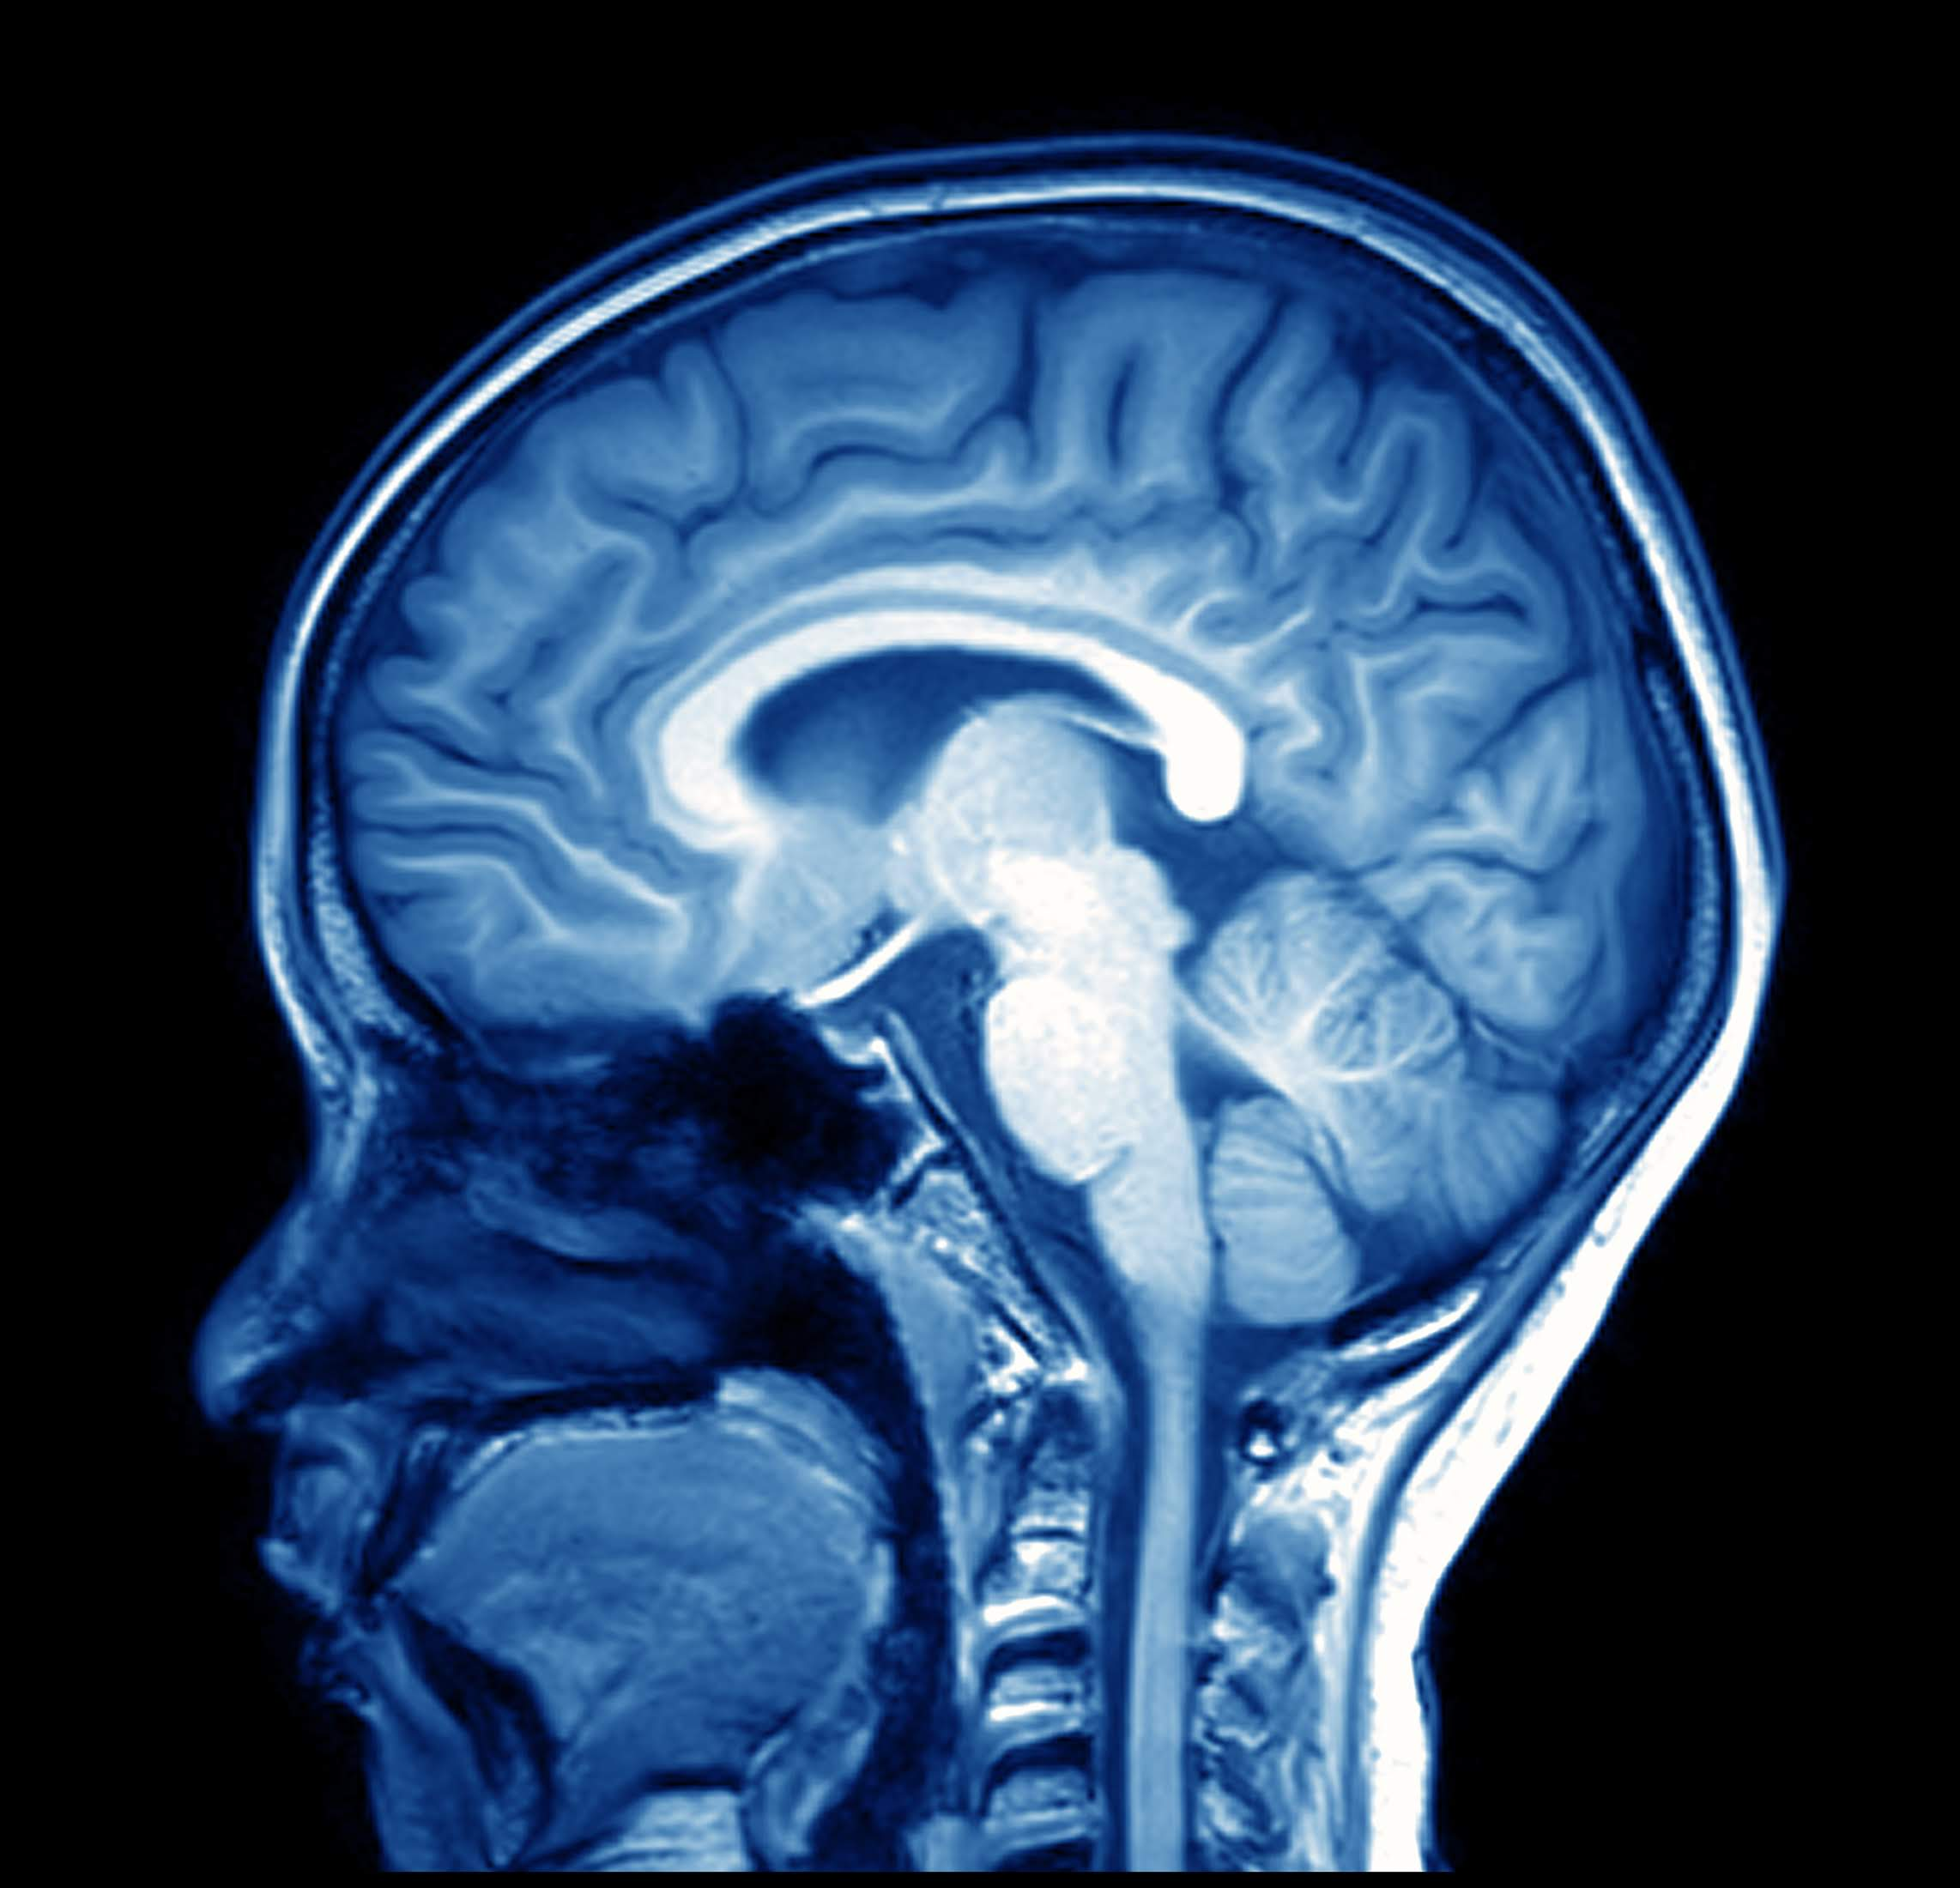
Imaging
Notes:
The techniques pioneered for creating and processing radio images has been brought to medicine. The same process of handling multiple antennae as an interferometer are being used to take the MRI data and convert it to life saving information for doctors. This same technology is also used in the geological mapping of our ocean floors. Additionally, by using only certain frequencies while scanning the Earth from space, scientists have been able to monitor deforestation and glacial flows.
Reference:
<ul>
<li>https://nap.nationalacademies.org/read/12800/chapter/5#101</li>
<li>https://theodc.net/home/magnetic-resonance-image-mri-of-the-brain/</li>
</ul>

Slide 38
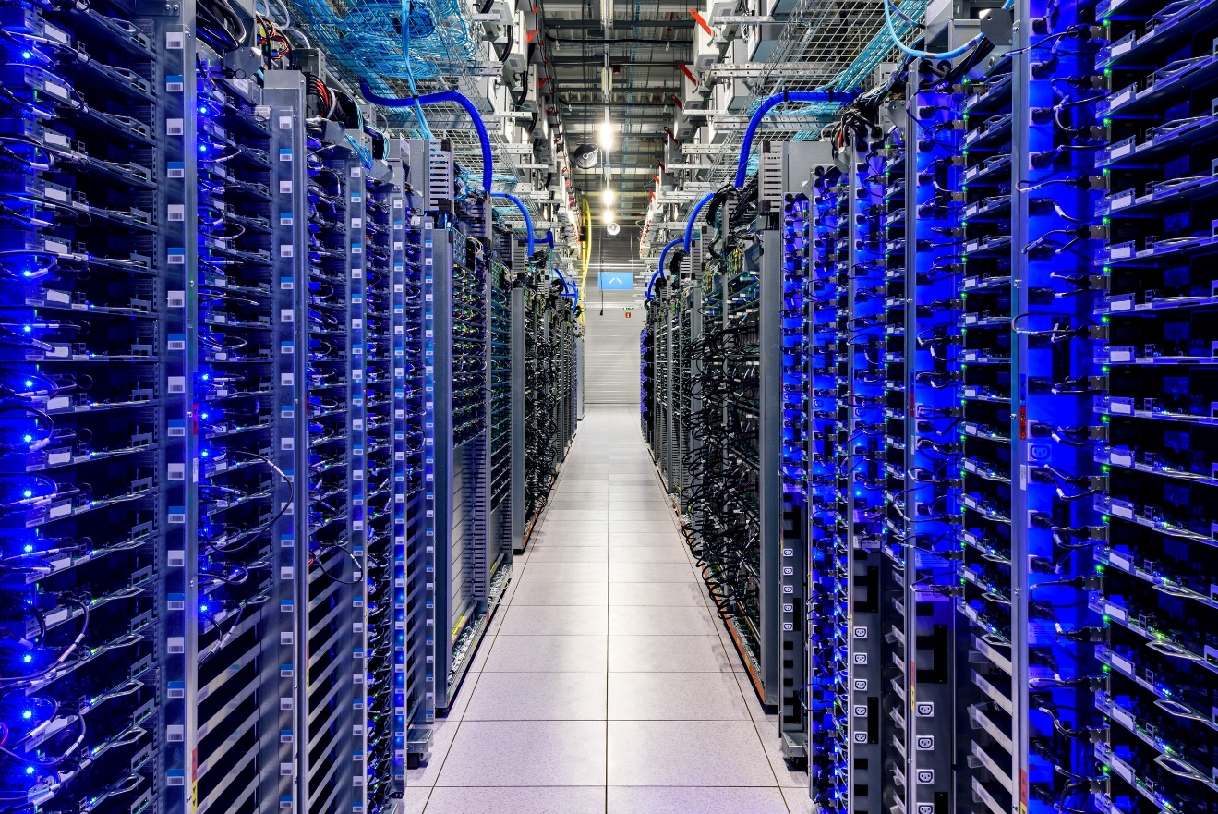
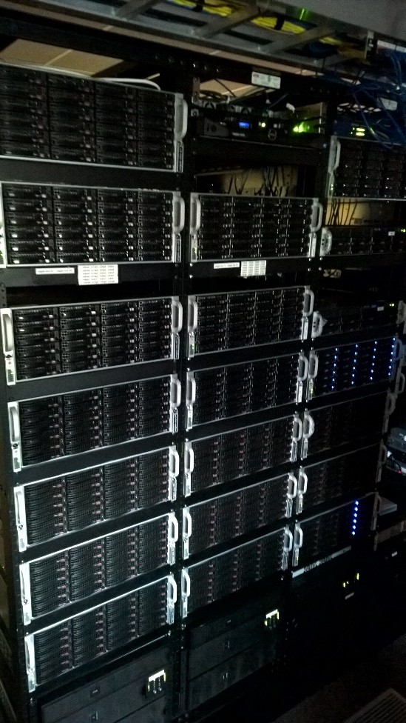
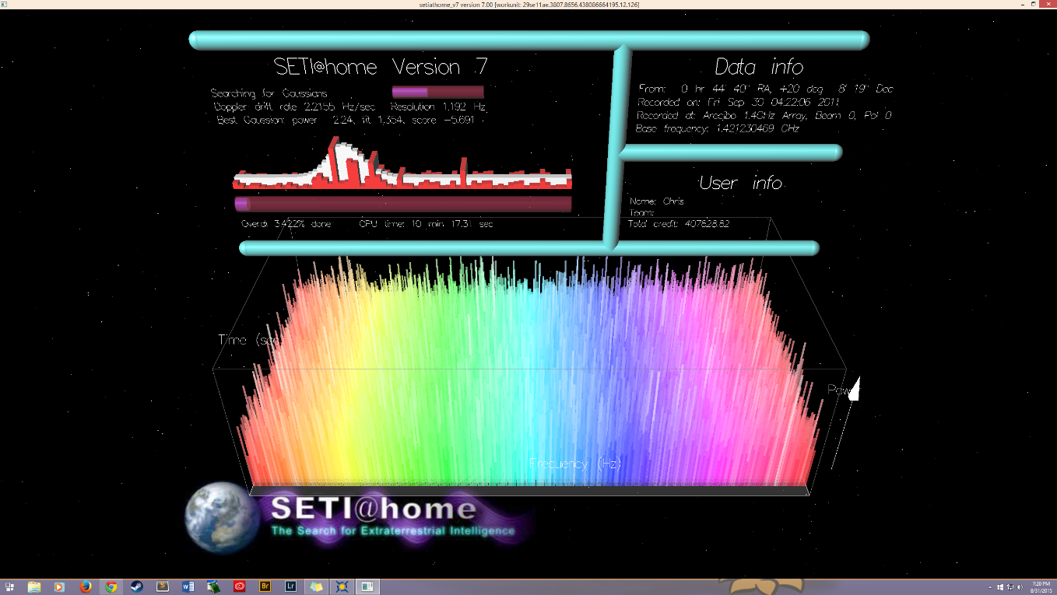
Computing
Notes:
The data received is truly enormous. Starting with local systems, radio astronomy processing has grown to use extremely distributed systems. To process the data, new techniques were created to harness multiple computers together. Everything from local processing on multiple computers to large data centers to SETI@Home are used to process the information. These techniques have spread around the computing world.

Slide 39
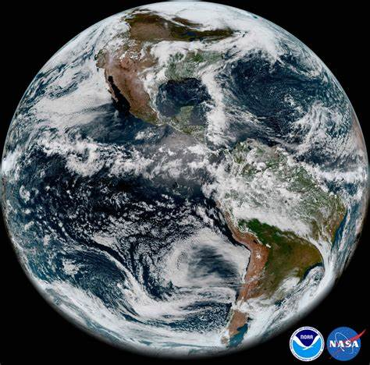
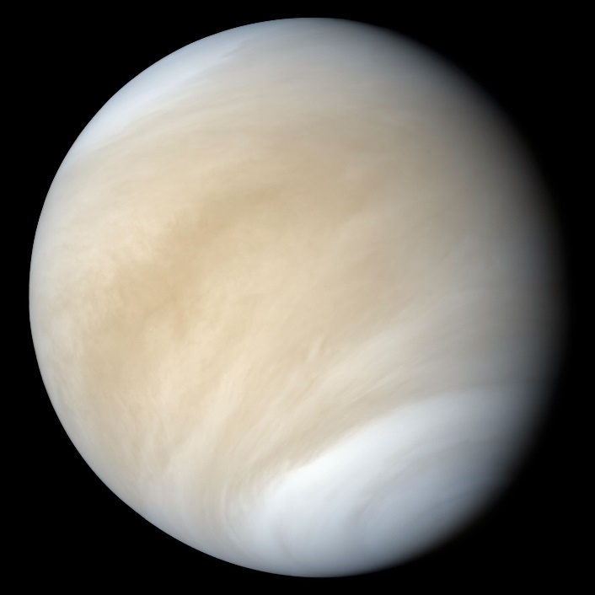
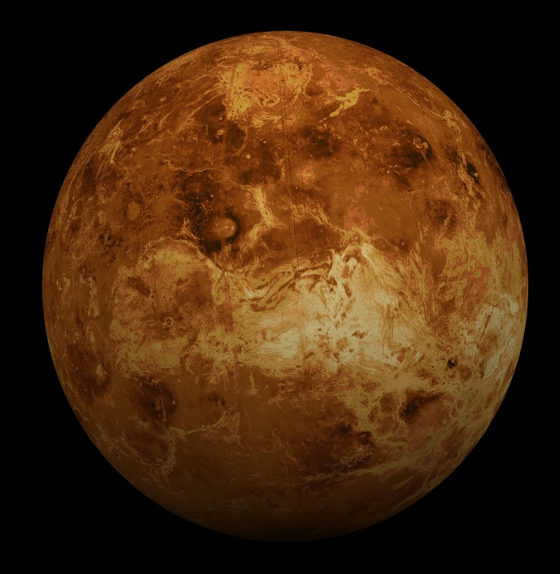
Our atmosphere
Astmospheric Change
Notes:
Venus is an odd planet. About the same size as Earth. About the same mass. Why is it so different? The research into this question has provided new ideas, areas of inquiry and actions for us here on Earth.
Probably the most influential is…

Slide 40
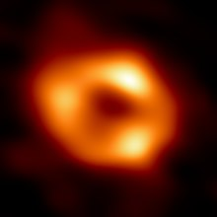
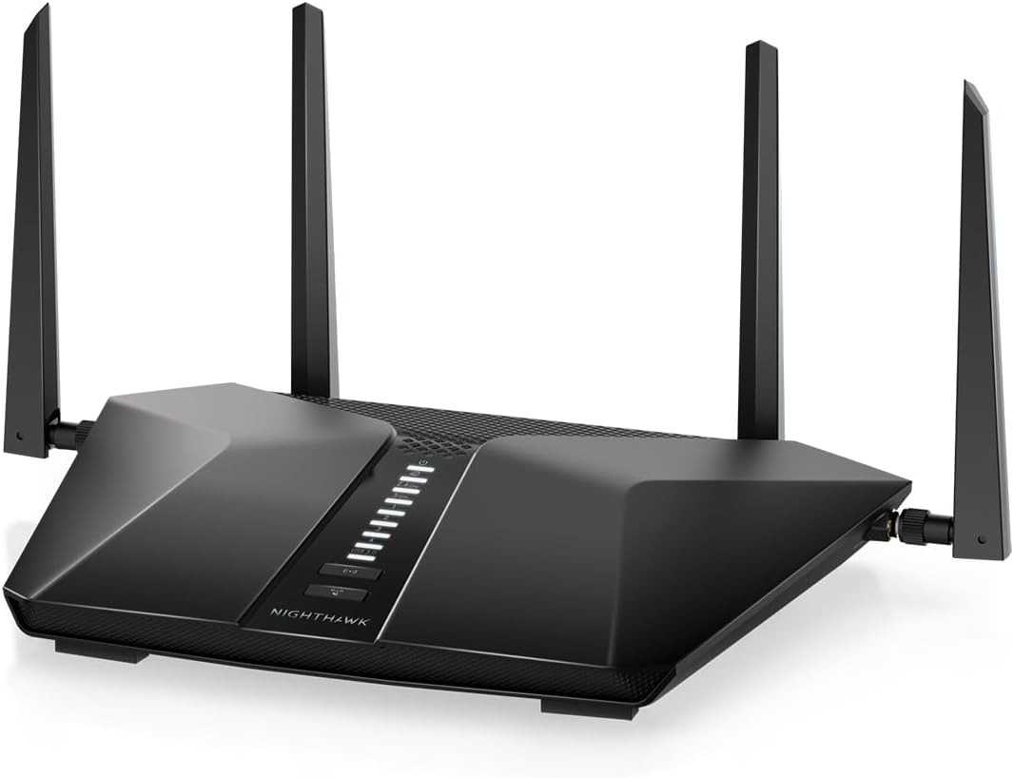
Wi-Fi
Notes:
As part of the Event Horizon Telescope preparation, Commonwealth Scientific and Industrial Research Organization (CSIRO) in Australia realized that the environment of a black hole was extremely complicated electromagnetically. Their research found that the same electromagnetic wave had a complex and torturous route to escape the accretion disk. They realized that Wi-Fi signals bounce around within buildings as well as off of building and many other objects. Their research has allowed Wi-Fi as well as cell phones to have much stronger and reliable communicates.
References
<ul>
<li>From Medicine to Wi-Fi, Technical Applications of Astronomy to Society. Published by IAU April 2019.</li>
</ul>

Slide 41

Pure Curiosity
Notes:
Whenever mankind has started asking questions, we’ve found answers. Not only answers to the questions we ask but the knowledge to ask new questions.
Research does not always immediately provide a benefit. Sometimes it takes time to see a solution… e.g. GPS.

Slide 42
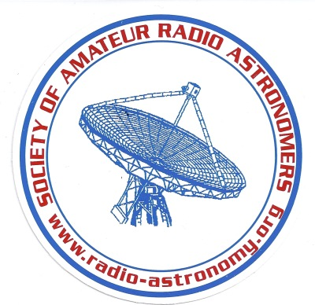
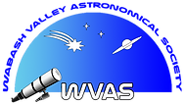
Questions?
WVAS
https://www.wvastro.org/
SARA Forum: https://groups.google.com/forum/#!forum/sara-list
Notes:
Thank you for your time. I hope I’ve given you the basic information to start thinking about radio astronomy as a hobby. If you go to the SARA web site and click on the education menu, you can get a lot of good information. Additionally, a lot of information is on the Radio Jove site. SARA is a non-profit organization that does a LOT of outreach and education.
Questions?

